Slide 1
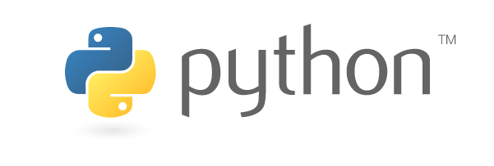
An introduction to machine learning with
Håkon Hapnes Strand Consultant in Insights & Data

Slide 2
Download Python 3.x from https://www.anaconda.com/download/

Slide 3
Agenda
0. The What, Why and How of Python
Python download and setup
Jupyter Notebook
Basic Python syntax
Core data science libraries
Machine learning case
Brief introduction to NLP (if time)

Slide 4
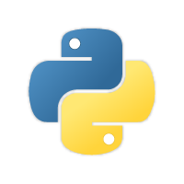
What?
Python is a general-purpose, interpreted programming language.
Developed by Dutch programmer Guido van Rossum and released in 1991.

Slide 5
Why?
Python is the 4th most popular programming language in the world (https://www.tiobe.com/tiobe-index/), the highest it’s ever been.
Python is open-source.
Python’s recent rise in popularity is largely due to the rise of data science and machine learning.
Python has more than 1000 packages more or less related to data science.
Python has a great community.
Python is easy and fun!

Slide 6
How?
We’ll try to cover that next…

Slide 7
Agenda
0. The What, Why and How of Python
Python download and setup
Jupyter Notebook
Basic Python syntax
Core data science libraries
Machine learning case
Brief introduction to NLP (if time)

Slide 8

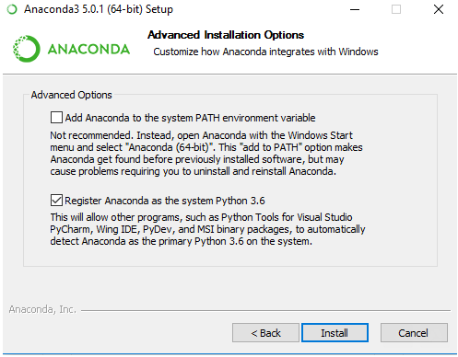
The Anaconda distribution
Python distribution specifically aimed at data science.
~433 packages preinstalled (basically everything you need for ML)
Download Python 3.x from https://www.anaconda.com/download/
Anaconda includes the conda package manager.
conda cheat sheet: https://conda.io/docs/_downloads/conda-cheatsheet.pdf
Add Python manually to path
Something like C:\ProgramData\Anaconda3 and C:\ProgramData\Anaconda3\Scripts

Slide 9
Python 3 vs. 2
Python 3 is the future and present. Python 2 is legacy.
Check Python 3 compatibility at http://py3readiness.org/.
The main differences in Python 3:
Strings are unicode by default.
Integer division returns float by default.
print() is now a function.

Slide 10
Agenda
0. The What, Why and How of Python
Python download and setup
Jupyter Notebook
Basic Python syntax
Core data science libraries
Machine learning case
Brief introduction to NLP (if time)

Slide 11
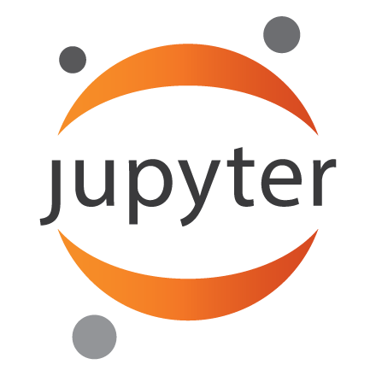
Jupyter Notebook
Short for Julia/Python/R.
IDE with REPL environment that runs in the browser.
Comes preinstalled with Anaconda.
Run with the console command jupyter-notebook.
Magic commands: http://ipython.readthedocs.io/en/stable/interactive/magics.html

Slide 12
Agenda
0. The What, Why and How of Python
Python download and setup
Jupyter Notebook
Basic Python syntax
Core data science libraries
Machine learning case
Brief introduction to NLP (if time)

Slide 13
All code will be available at https://github.com/HStrand/python-ml101

Slide 14
Syntax
Python is weakly typed.
Python uses indentation to determine code blocks.
No curly braces or semicolons!

Slide 15
Agenda
0. The What, Why and How of Python
Python download and setup
Jupyter Notebook
Basic Python syntax
Core data science libraries
Machine learning case
Brief introduction to NLP (if time)

Slide 16
Data science libraries
Most Python data science packages are built around the NumPy stack
The most important packages are:
NumPy for working efficiently with arrays and matrices.
pandas to work with table data.
scikit-learn for machine learning.
matplotlib and seaborn for visualization.

Slide 17
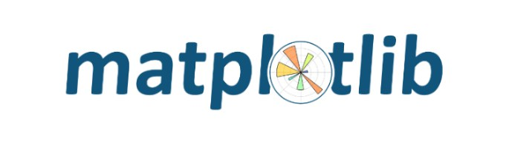
matplotlib and seaborn
matplotlib is a simple and easy-to-use visualization package.
seaborn adds prettier graphics and additional plot types.
Seaborn examples at https://seaborn.pydata.org/examples/index.html

Slide 18

scikit-learn
scikit-learn is an excellent tool for machine learning.
It has really good documentation at http://scikit-learn.org/stable/.
Works well with small data.
Does not work well with big data and deep learning.
For deep learning, there are multiple specialized libraries with Python APIs, like TensorFlow, PyTorch, CNTK, etc. etc.

Slide 19
Agenda
0. The What, Why and How of Python
Python download and setup
Jupyter Notebook
Basic Python syntax
Core data science libraries
Machine learning case
Brief introduction to NLP (if time)

Slide 20
The Titanic case
A getting-started competition at Kaggle: https://www.kaggle.com/c/titanic
The case: Predicting who will die in the Titanic disaster.

Slide 21
Agenda
0. The What, Why and How of Python
Python download and setup
Jupyter Notebook
Basic Python syntax
Core data science libraries
Machine learning case
Brief introduction to NLP (if time)

Slide 22
Natural Language Processing (NLP)
Using algorithms to «understand» text.
Some popular packages:
gensim for finding words with similar meanings. Implements the Word2vec algorithm.
NLTK (Natural Language Toolkit) for text processing and test data.
There are many others…

